Slide 1
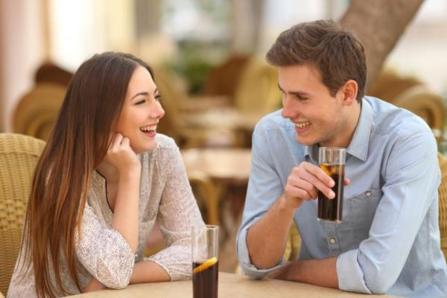

Listen and practice
David: Hello, I’m David Garza. I’m a new club member.
Beth: Hi. My name is Elizabeth Silva, but please call me Beth.
David: OK. Where are you from, Beth?
Beth: Brazil. How about you?
David: I’m from Mexico.
Beth: Oh, I love Mexico! It’s really beautiful.
David: Thanks. So is Brazil!
Beth: Oh, good. Sun Hee is here.
David: Who’s Sun Hee?
Beth: She’s my classmate. We’re in the same math class.
David: Where’s she from?
Beth: Korea. Let’s go and say hello. Sorry, what’s your last name again? García?
David: Actually, it’s Garza.
Beth: How do you spell that?
David: G-A-R-Z-A.

Slide 2
§ Greetings Good morning/ afternoon/ evening. Nice to see you again. I’m glad/ happy/ pleased to see you. How are you? - Fine, thanks. And you? How are things? - Not too bad, thanks. | § Introductions Introducing oneself Can I introduce myself? My name’s Peter. I’d like to introduce myself. I’m … . -Introducing someone else Can I introduce a good friend of mine? This is … I’d like you to meet … .
Making contact Excuse me, are you Mrs … ? - Yes, that’s right. Hello, you must be Mrs … . How do you do? - How do you do? Nice to meet you. - Nice to meet you, too. Please, call me … . - Then you must call me … . | § Good-byes Good bye/ Bye / See you later/ See you soon. I must go now. I’m afraid I’ve got to go. Have a good weekend. - Same to you. I hope to see you again. - I hope so, too.

Slide 3
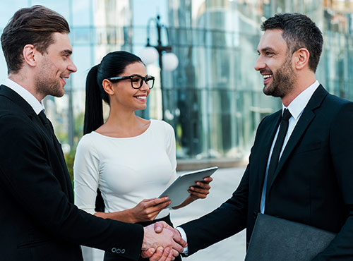
Naturally speaking
Mr Brown meets Mrs Miller, one of his students, and her husband in the street.
Mr Brown: | Good morning, Mrs Miller.
Mrs Miller : | Good morning, Mr Brown. How are you?
Mr Brown: | I'm fine thanks, and you?
Mrs Miller: | Not too bad. Mr Brown, this is my husband Michael, Michael this is Mr Brown my English teacher.
Mr Miller: | Pleased to meet you.
Mr Brown: | Pleased to meet you too. Are you from Germany, Mr Miller?
Mr Miller: | Yes, East Germany, from Dresden. And you? Are you from London?
Mr Brown: | No, I'm from Wales, but I live in London now.
Mrs Miller: | Well, goodbye Mr Brown, it was nice to see you.
Mr Brown: | Yes, goodbye.

Slide 4
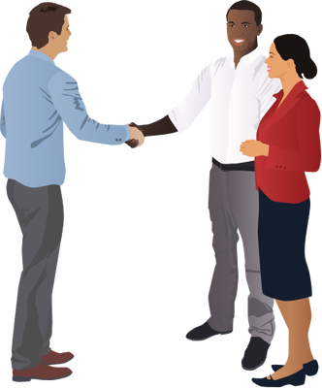
Task 1. Make a conversation to introduce someone else. Write a conversation for this situation and practice it.

